Slide 1
Power Calculation
Review:
Central Limit Theorem
Hypothesis Testing
Type I vs Type II errors
What is “Power”?
Calculating Power / Sample Size
A/B Testing w/ Power
Ryan Henning

Slide 2
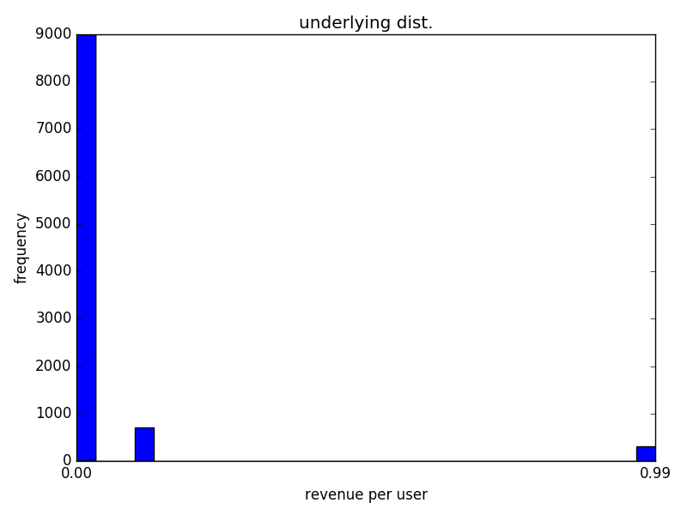
Distribution of website revenue per visitor
Underlying Distribution:
Random variable: X = revenue per visitor | P(X):
X = $0.00 (no revenue) | 90%
X = $0.10 (ad-click) | 7%
X = $0.99 (app purchase) | 3%
Notes:
We have a website with ads and a product. Here’s our distribution of revenue per user. Most users (90%) do nothing that generates revenue. Some click ads (7% do, causes a little revenue) and some (3%) buy our app!

Slide 3
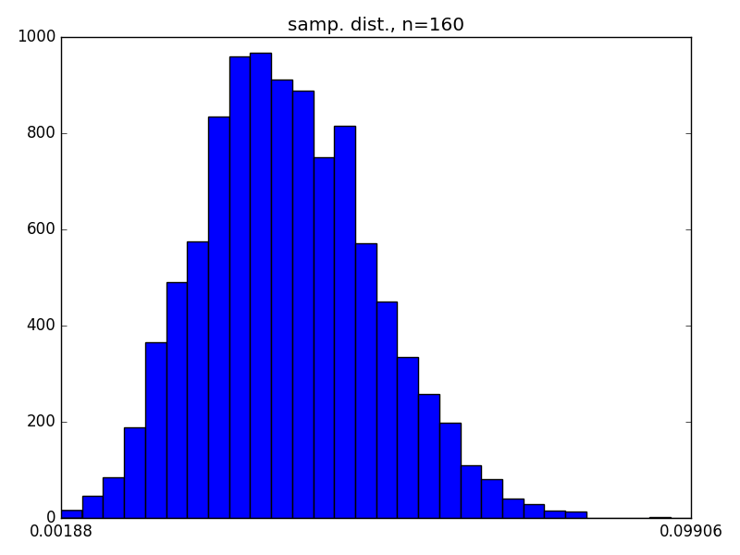


Distribution of sample means
Collect n samples from the website revenue distribution, calculate the sample mean
Repeat 10,000 times, we get:
Plot all 10,000 sample means.
Notes:
Previously we were plotting the histogram of single samples. What if we plot a histogram of sample means? Here’s what you get! Here’s the histogram of sample means where each mean is the average of 160 website users.
This is called the “sampling distribution”.

Slide 4
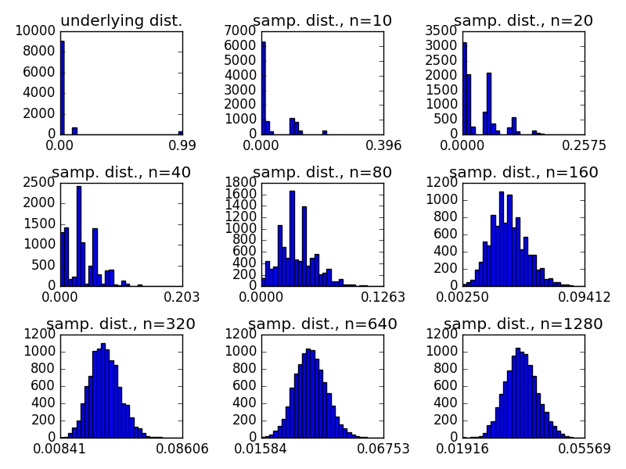
Central Limit Theorem
Notes:
What is the Central Limit Theorem?
It states: The distribution of sample means (aka, the “sampling distribution”) is normally distributed, no matter what the underlying distribution is!
'''
Play with the central limit theorem.
'''
import matplotlib.pyplot as plt
import numpy as np
def sample_from_unknown_distribution(num_samples):
uniform = np.random.uniform(0., 1., num_samples)
vals = []
for val in uniform:
if val < 0.9:
val = 0.00
elif val < 0.97:
val = 0.10
else:
val = 0.99
vals.append(val)
return np.array(vals)
def plot_histogram(data, bins=30):
plt.xticks(np.linspace(np.min(data), np.max(data), 2))
plt.hist(data, bins)
def plot_histogram_alt(data, bins=30):
hist, bins = np.histogram(x, bins=bins)
width = 0.7 * (bins[1] - bins[0])
center = (bins[:-1] + bins[1:]) / 2
plt.bar(center, hist, align='center', width=width)
plt.xticks(np.linspace(0., 0.3, 2))
if __name__ == '__main__':
num_datapoints = 10000
# 1-sample
x = sample_from_unknown_distribution(num_datapoints)
plt.subplot(3, 3, 1)
plt.title("underlying dist.")
#plt.xlabel("revenue per user")
#plt.ylabel("frequency")
plot_histogram(x)
# n-samples
for index, n in enumerate([10, 20, 40, 80, 160, 320, 640, 1280]):
x = [np.mean(sample_from_unknown_distribution(n))
for i in range(num_datapoints)]
plt.subplot(3, 3, index+2)
plt.title("samp. dist., n="+str(n))
#plot_histogram_alt(x)
plot_histogram(x)
plt.tight_layout()
plt.show()

Slide 5
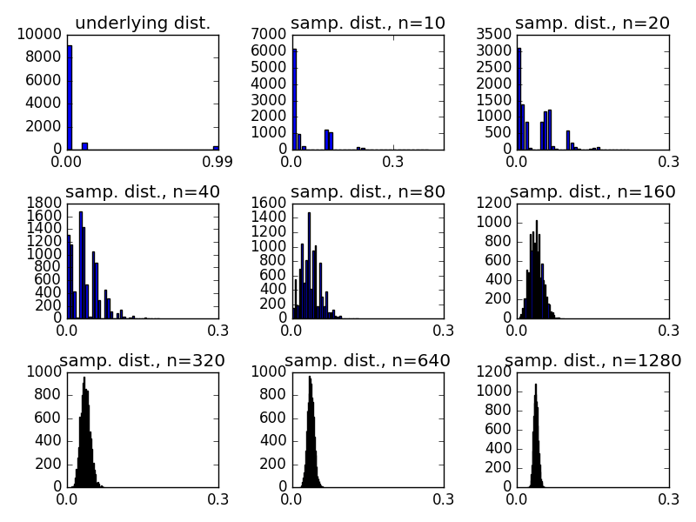
Central Limit Theorem: What happens when the sample size increases?
Notes:
What happens to the sampling distribution when the sample size increases?
1. The distribution becomes more normal.
2. The variance & standard deviation decreases.
What happens to the mean of the sampling distribution when the sample size increases?
It stays the same. (But recall, the variance decreases.)

Slide 6
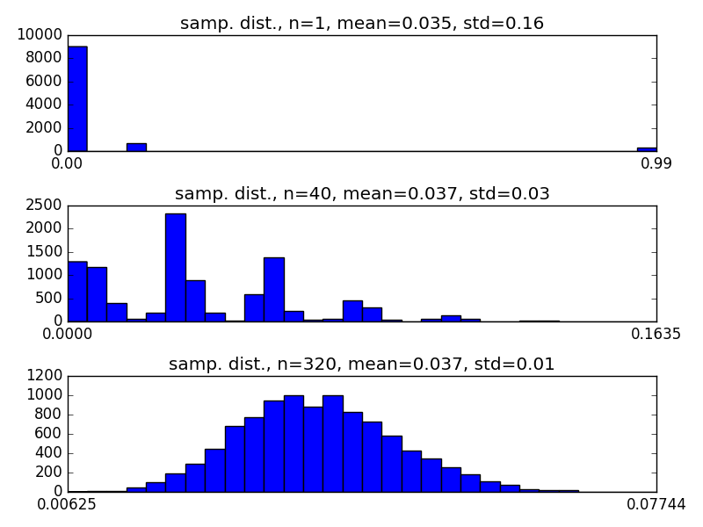
Intuitively, does the Central Limit Theorem make sense?
Intuitively, why does the mean stay the same in each histogram?
Intuitively, why does the std. dev. decrease as the sample size increases?

Slide 7



Central Limit Theorem: Std. Dev precise relationship to sample mean
Let the underlying distribution have mean and std. dev.
The sampling distribution's mean and std. dev. will equal:
Notes:
We can see the exact relationship between std dev and the sample size here.
We’ll see this “divide by the root of the sample size” later in this presentation.

Slide 8



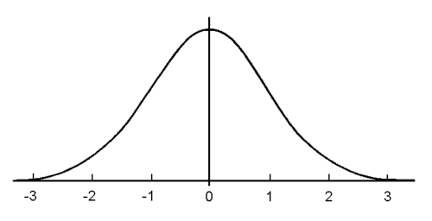


Hypothesis Testing: Review
Two-sided test:
One-sided test:
x = -1.96
x = 1.96
x = 1.645
Notes:
The pictures show a unit normal distribution (mean 0, std 1).
Explain the two-sided test. When do we reject H0? What ranges of x-bar will cause us to reject H0? If H0 is true, what’s the probability that we’ll reject H0 anyway?
Two-sided example: Imagine an email marketing campaign. Your boss asks “do these two emails give the same response?”
Explain the one-sided test. When do we reject H0? What ranges of x-bar will cause us to reject H0? If H0 is true, what’s the probability that we’ll reject H0 anyway?
One-sided example: Imagine an email marketing campaign. Your boss asks “does this second email sell more product than the first?”
It just matters what question you want to answer.

Slide 9
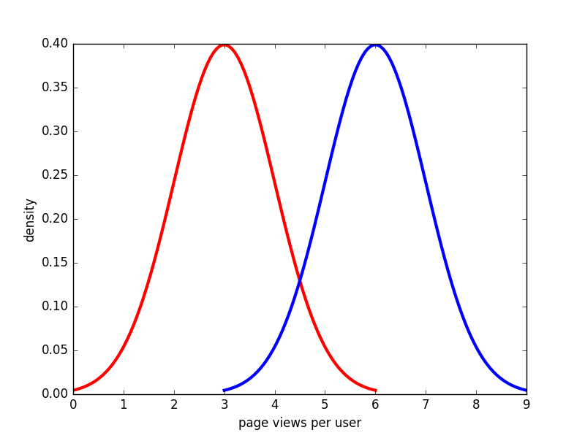
Guessing the unknown
H₀
H_{A}
Notes:
“Say you sample and you get some value, let’s say you get 4. You suspect that the underlying distribution is one of the two shown in this picture--either it’s the red or the blue distribution shown in this picture… but you’re not sure which it is. All you actually know is that you sampled and got a 4.
Can we guess at the underlying distribution? Did the 4 come from the red distribution or did it come from the blue distribution?
This is basically what we’re doing when we do hypothesis tests. We come up with a theory (our hypothesis), then we sample and see if it’s consistent with our hypothesis. The funny thing is, we can never be SURE of anything--we can only speak in terms of probability. So, we set an alpha value and let that be our cutoff for making decisions about the underlying distribution.
Not all experiments are created equal. Some are good experiments, and some are bad experiments.
What’s a bad experiment? It’s one where you can’t be very confident about the result… your confidence will be very low. For example, in this picture, if we sample and get a 4, can we be very confident about which distribution is the true distribution? Nope.
This leads us to the idea of an experiment’s POWER. We want to design experiments with high POWER.”
import matplotlib.pyplot as plt
import numpy as np
import matplotlib.mlab as mlab
import math
mean = 0
variance = 1
sigma = math.sqrt(variance)
x = np.linspace(-3, 3, 100)
plt.plot(x+3, mlab.normpdf(x, mean, sigma), 'r-', linewidth=3.0)
plt.plot(x+6, mlab.normpdf(x, mean, sigma), 'b-', linewidth=3.0)
plt.ylabel("density")
plt.xlabel("page views per user")
plt.show()

Slide 10
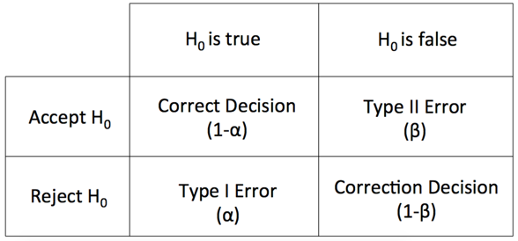
Hypothesis Testing: Possible Outcomes
We call this the experiment’s “Power”. It is the probability that we correctly reject H₀ when the null hypothesis is false.
Notes:
Here are the four possible outcomes of a statistical experiment. ...

Slide 11
Hypothesis Testing: Possible Outcomes
true -
true +
predict -
predict +
false positive rate (aka, 1 - specificity)
true positive rate (aka, sensitivity)
Notes:
This slide just goes over some terminology that you may come accross.
specificity is the true negative rate

Slide 12
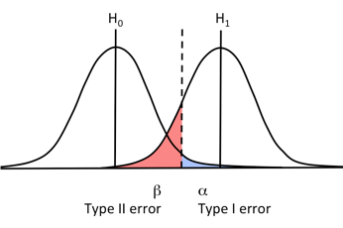
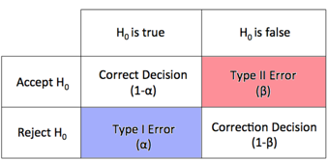
Hypothesis testing: the power region
The power measurement is in relationship to a specific alternative hypothesis. Think of it as the power to detect a particular “effect size”.
Notes:
The effect size is the amount of difference we’re trying to detect. E.g. Say we run an A/B test.

Slide 13
Hypothesis testing: the power region
What happens to power when we increase alpha?
Notes:
Draw on the board, see that increasing alpha increases power.

Slide 14
Hypothesis testing: the power region
What happens to power when we increase the effect size?
Notes:
Draw on the board, see that increasing effect size increases power.

Slide 15
Hypothesis testing: the power region
What happens to power when we increase the sample std. deviation?
Notes:
Draw on the board, see that increasing std. DECREASES the power.

Slide 16
Hypothesis testing: the power region
What happens to power when we increase the sample size?
Notes:
Draw on the board, see that increasing sample size causes the std. to decrease, which increases power.

Slide 17
Hypothesis testing: the power region
We then calculate the sample size needed to get what we want!
Often, we know:
The “effect size” that we want to detect, and
The power that we want to achieve.

Slide 18



Hypothesis testing (revised with power calculation)
Decide to run an experiment, choose
Calculate required sample size
Take sample, obtain
Accept or reject H₀
(new steps)

Slide 19
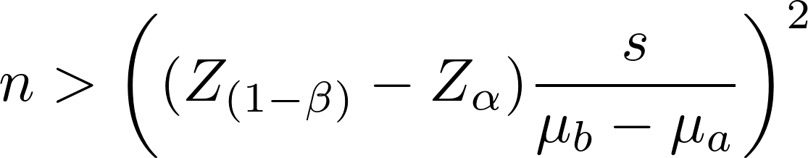
Calculating the required sample size
To the white board...
import scipy.stats as st
st.norm.ppf(alpha)
st.norm.ppf(1 - beta)
Notes:
n > \left( (Z_{(1-\beta)} -Z_\alpha) \frac{s}{ \mu_b-\mu_a } \right)^2
ppf = “Percent point function” (Inverse of CDF)
http://docs.scipy.org/doc/scipy/reference/tutorial/stats.html
s, u_b, and u_a can come from:
research literature, or
a pilot experiment, or
from one’s … head

Slide 20
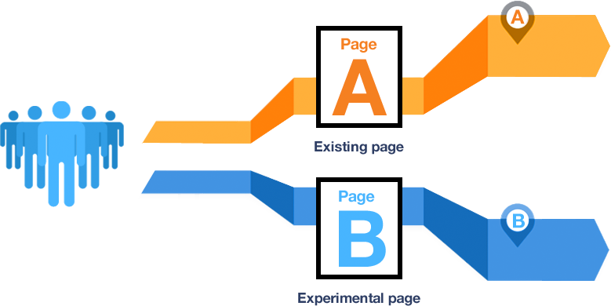
A/B Testing
Image from: http://techcrunch.com/2014/06/29/ethics-in-a-data-driven-world/

Slide 21

A/B Testing
Setup: A/B Test our website’s homepage.
Our current homepage has a signup conversion rate of 6%. (The standard deviation would be 0.24.)
We want to test a new homepage design to see if we can get a 7% signup rate. We’ll want an experiment where alpha is 1% and power is 95%.
How many visitors must visit the new homepage in order to fulfill the requirements of this experiment?
Notes:
Comments:
alpha of 1% is probably overly cautious. Typically we set it to 5%.
power of 95% is also very aggressive. Typically it’s 80% or 90%.
Q:Why not collect more than the minimum required visitors? What’s the harm in collecting more visitors than we need?
A: In the case that the new page underperforms, we’ll take a revenue hit. So we only want to run the page for the minimum amount of time needed to draw a conclusion.
To get the answer, run my program: power.py
What’s the standard deviation for this test: Well, we’re dealing with a Bernoulli random variable. The std dev is sqrt(p(1-p)). See:
https://en.wikipedia.org/wiki/Bernoulli_distribution
Also see:
https://www.optimizely.com/resources/sample-size-calculator/?conversion=6&effect=16&significance=95
http://www.evanmiller.org/ab-testing/sample-size.html
https://signalvnoise.com/posts/3004-ab-testing-tech-note-determining-sample-size

Slide 22

A/B Testing
Setup: A/B Test our website’s homepage.
Our current homepage has a signup conversion rate of 1%. (The standard deviation would be 0.099.)
We want to test a new homepage design to see if we can get a 1.2% signup rate. We’ll want an experiment where alpha is 1% and power is 95%.
How many visitors must visit the new homepage in order to fulfill the requirements of this experiment?
Notes:
Intuitively, why do we need more?

Slide 23

A/B Testing
Setup: A/B Test our website’s homepage.
Our current homepage has a signup conversion rate of 20%. (The standard deviation would be 0.4.)
We want to test a new homepage design to see if we can get a 30% signup rate. We’ll want an experiment where alpha is 1% and power is 95%.
How many visitors must visit the new homepage in order to fulfill the requirements of this experiment?
Notes:
Intuitively, why do we need less?
Great review of power calculations: https://www.youtube.com/watch?v=9lyCnLznAfs

Slide 24
Bayesian Inference
Frequentists vs. Bayesian
Bayes’ Rule
Prior, likelihood, posterior distributions
Ryan Henning

Slide 25


Intuition
What is the probability that it rained in my city last night?
(No info is given about which city I’m currently in.)
What is the probability that it rained in my city last night given that I live in San Francisco?

Slide 26
Intuition
What is the probability that it rained in my city last night?
(No info is given about which city I’m currently in.)
What is the probability that it rained in my city last night given that I live in San Francisco and I see that the road is wet?
Notes:
Probability is our measure of certainty.
We evaluate probability as a function of our prior knowledge and of our observations.

Slide 27
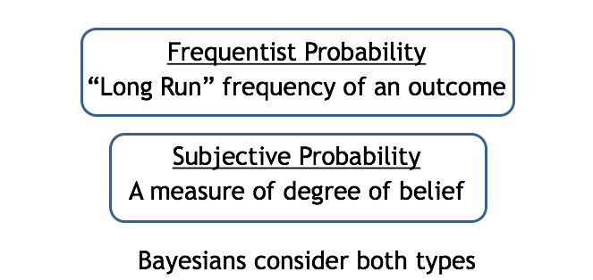
Frequentist vs. Bayesian

Slide 28


Frequentist vs. Bayesian
Experiment 1:
A fine classical musician says he’s able to distinguish Haydn from Mozart.
Small excerpts are selected at random and played for the musician.
Musician makes 10 correct guesses in exactly 10 trials.
Experiment 2:
Drunken man says he can correctly guess what face of the coin will fall down, mid air.
Coins are tossed and the drunken man shouts out guesses while the coins are mid air.
Drunken man correctly guesses the outcomes of the 10 throws.
Adapted example from Jim Berger’s book, The Likelihood Principle. Also adapted from Tammy Lee’s slides.

Slide 29


Frequentist vs. Bayesian
Frequentist: “They’re both so skilled! I have as much confidence in musician’s ability to distinguish Haydn and Mozart as I do the drunk’s to predict coin tosses”
Bayesian: “I’m not convinced by the drunken man…”
The Bayesian approach is to incorporate prior knowledge into the experimental results.

Slide 30
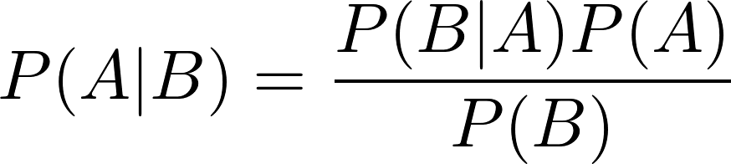
Bayes’ Rule
likelihood
prior probability
posterior probability
normalizing constant
Notes:
“a priori” is latin for “from the earlier”
“a posteriori” is latin for “from the latter”
Frequentists criticize Bayesians due to their use of the prior probability distribution, which they claim is non object, but is very subjective.
http://www.iep.utm.edu/apriori/
https://www.youtube.com/watch?v=i567qvWejJA&index=15&list=PLFDbGp5YzjqXQ4oE4w9GVWdiokWB9gEpm

Slide 31
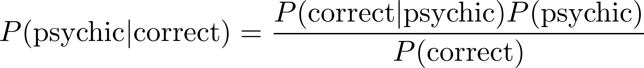
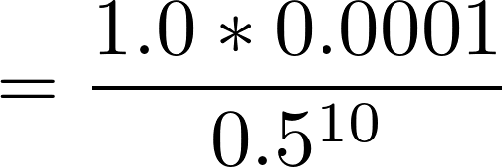

Bayes’ Rule: Example
arbitrary?

Slide 32
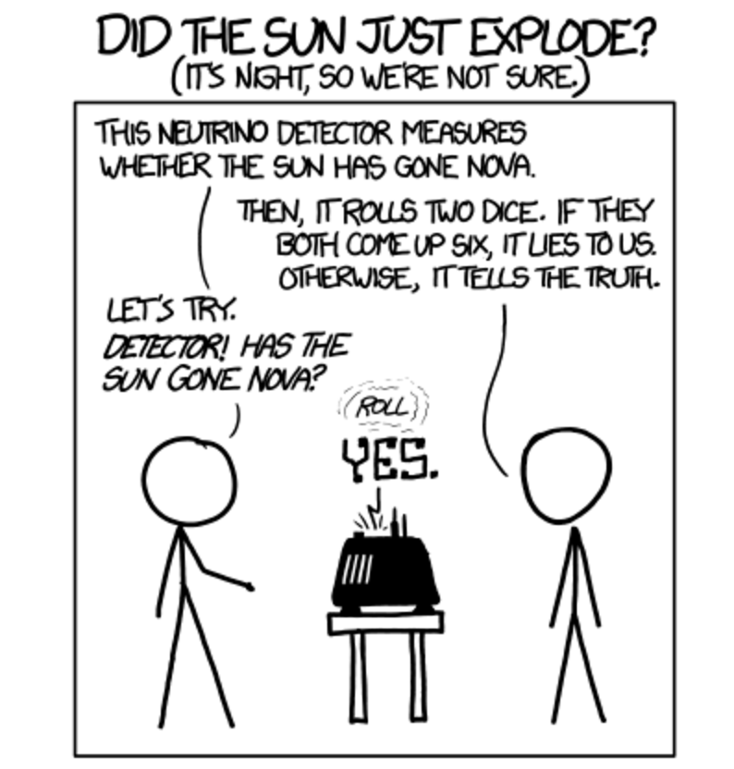
xkcd: Frequentists vs. Bayesians (#1132)
Notes:
https://xkcd.com/1132/

Slide 33
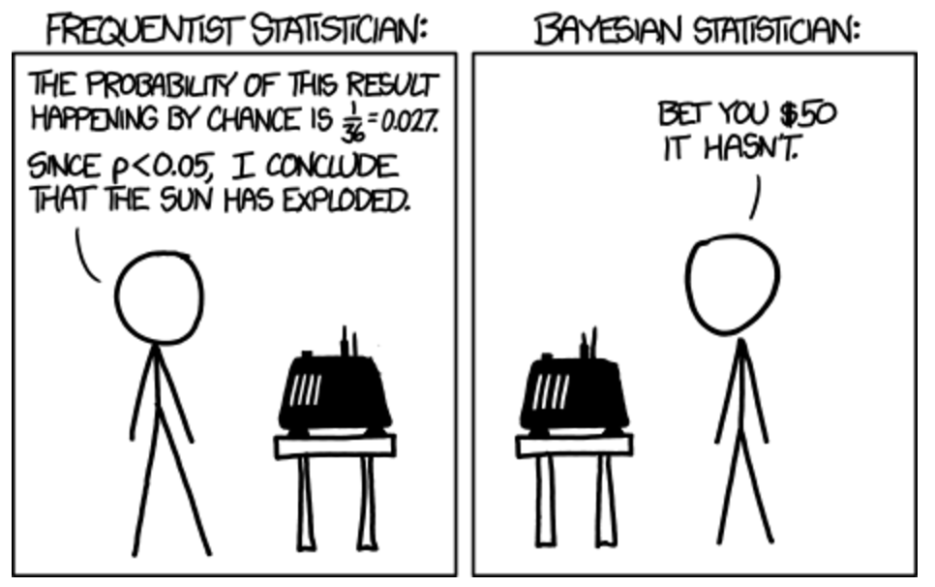
xkcd: Frequentists vs. Bayesians (#1132)
Notes:
https://xkcd.com/1132/

Slide 34
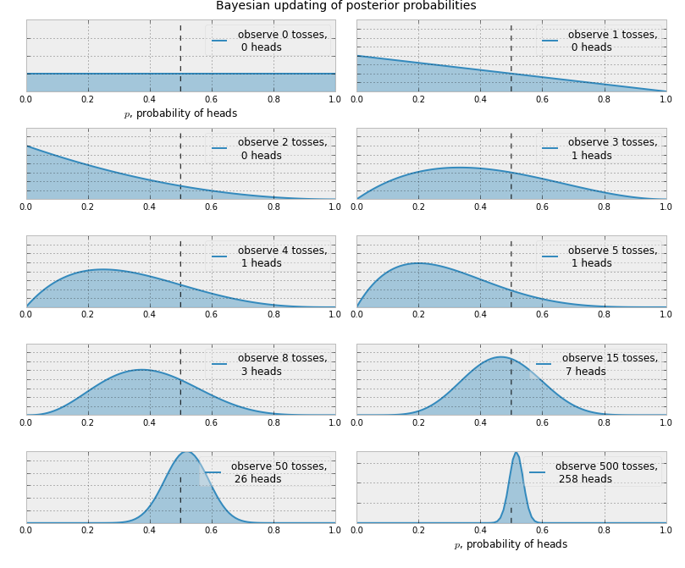
Bayesian Updates

Slide 35
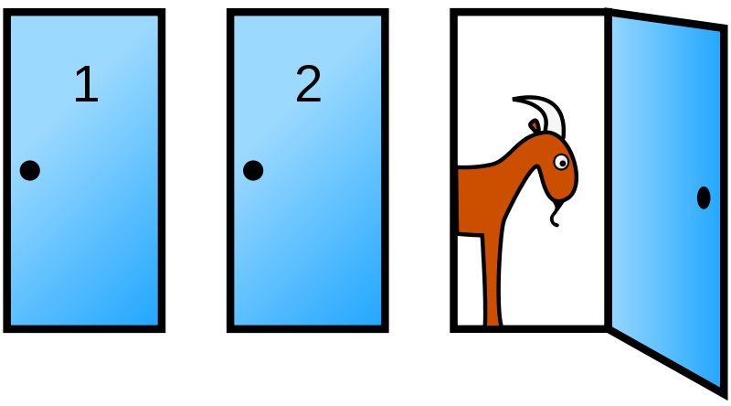

Monty Hall Problem
Notes:
https://en.wikipedia.org/wiki/Monty_Hall_problem

